Slide 1
Chapter 9

Slide 2
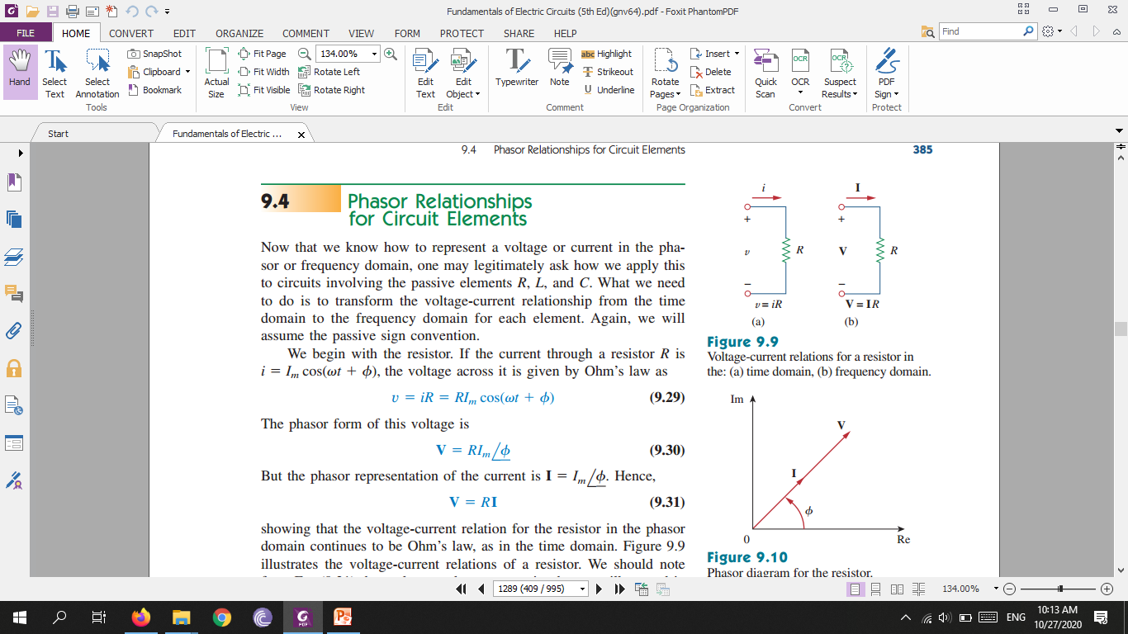

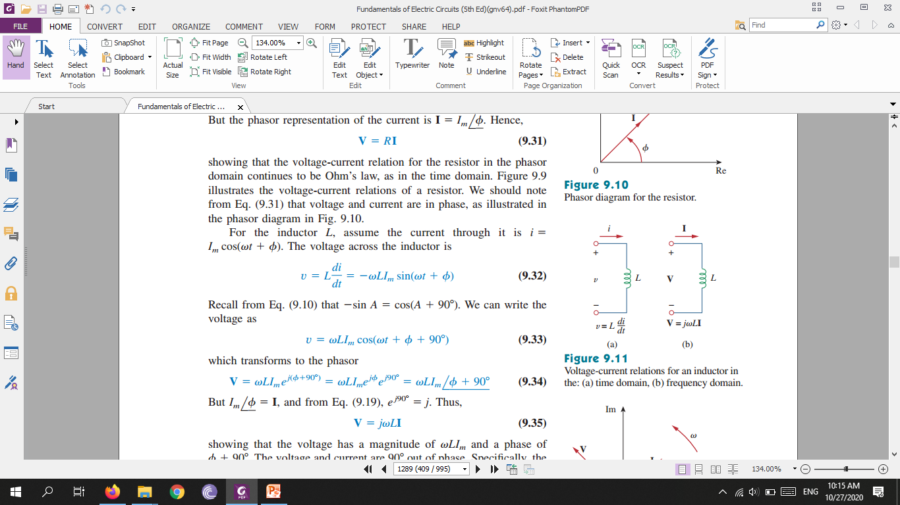
Phasor Relationships for Circuit Elements

Slide 3
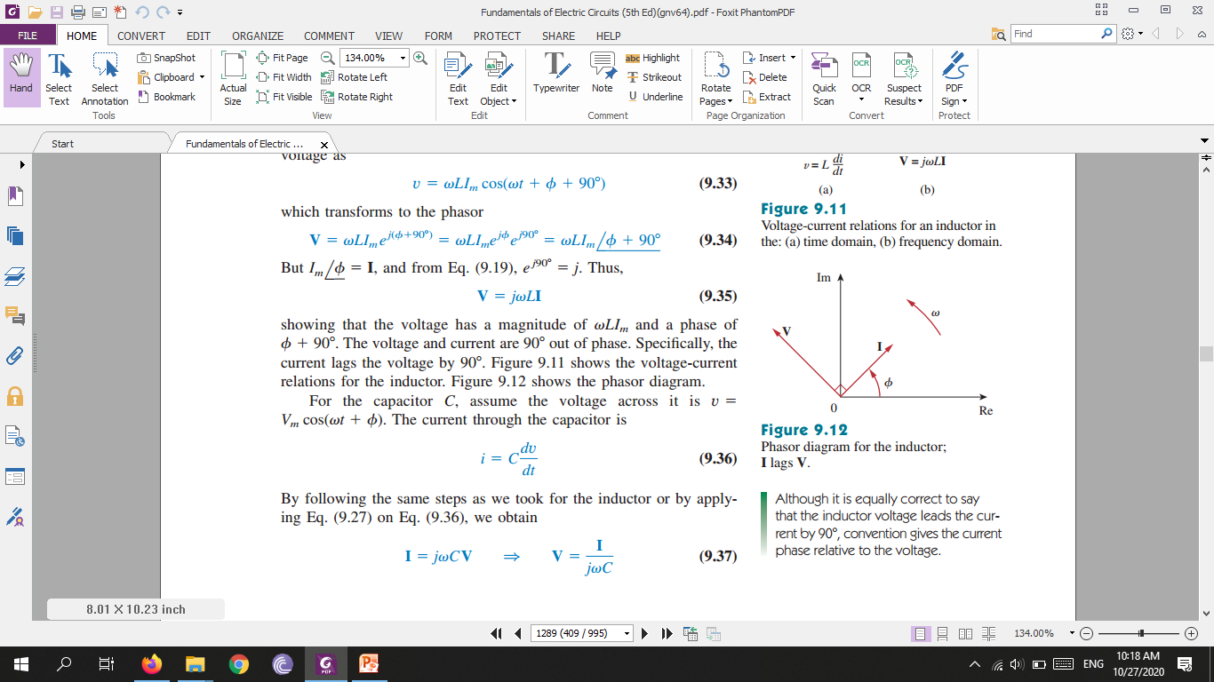
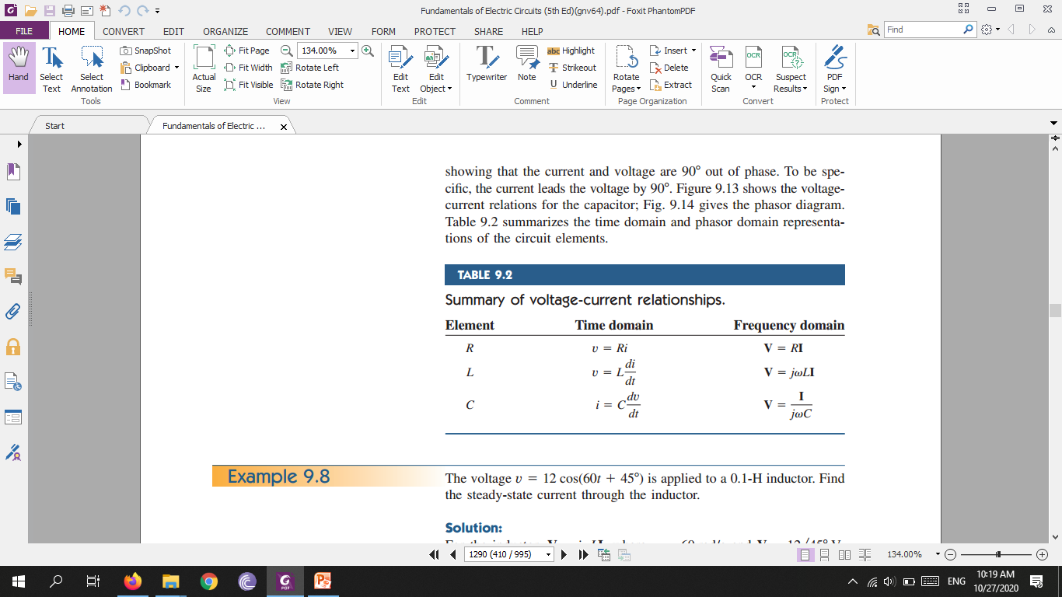

Slide 4
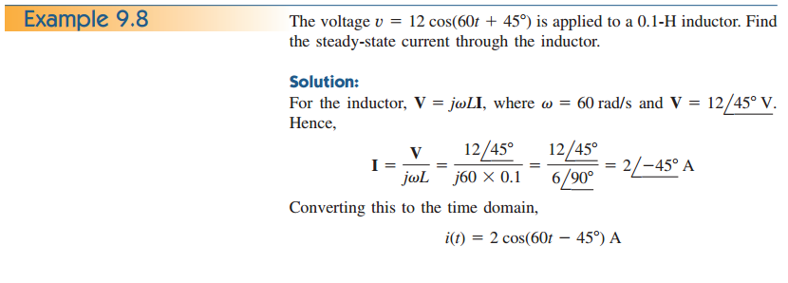

Slide 5
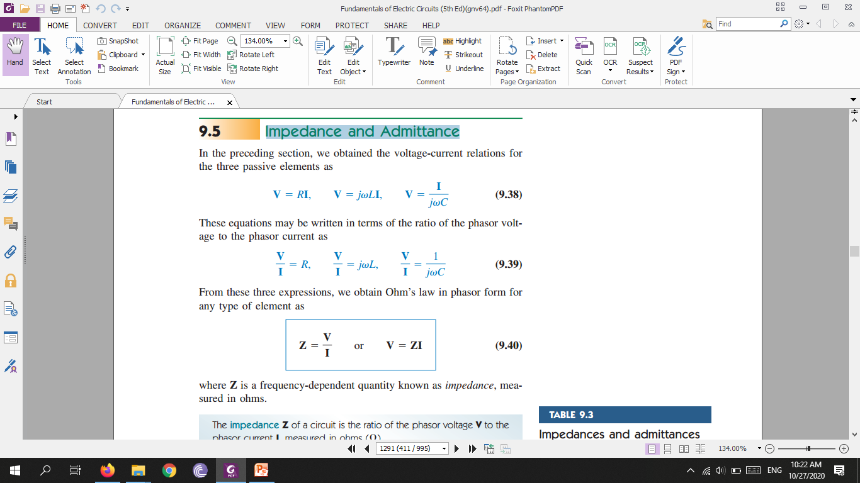
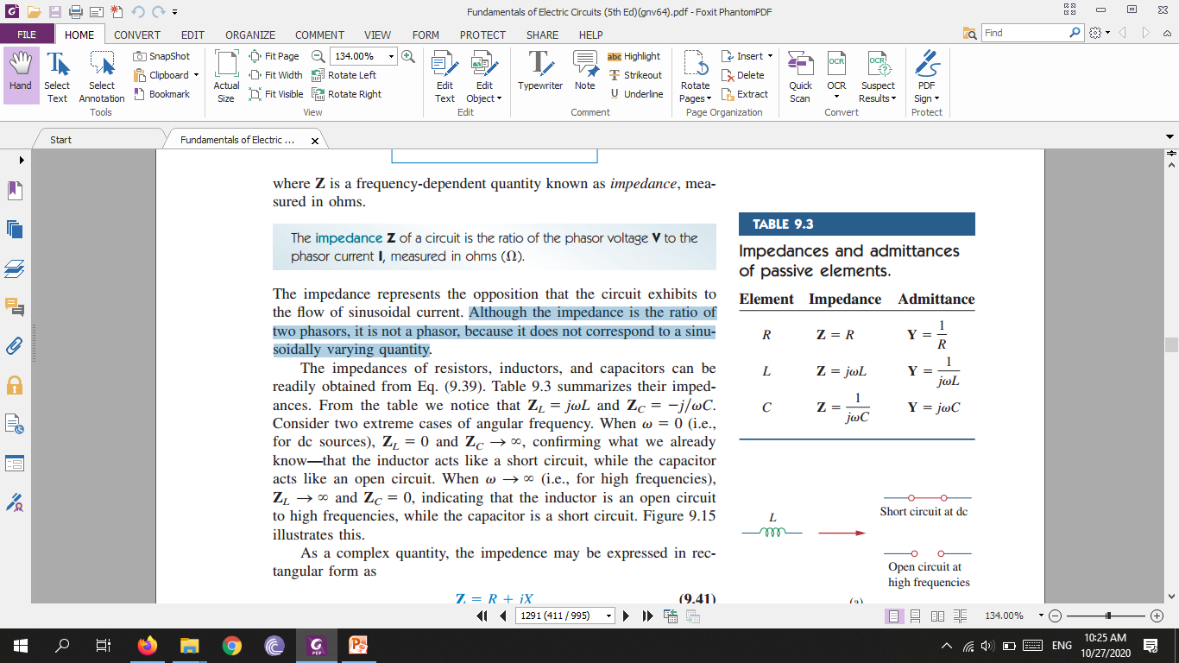
Impedance and Admittance
where Z is a frequency-dependent quantity known as impedance, measured in ohms.
Although the impedance is the ratio of two phasors, it is not a phasor, because it does not correspond to a sinusoidally varying quantity

Slide 6
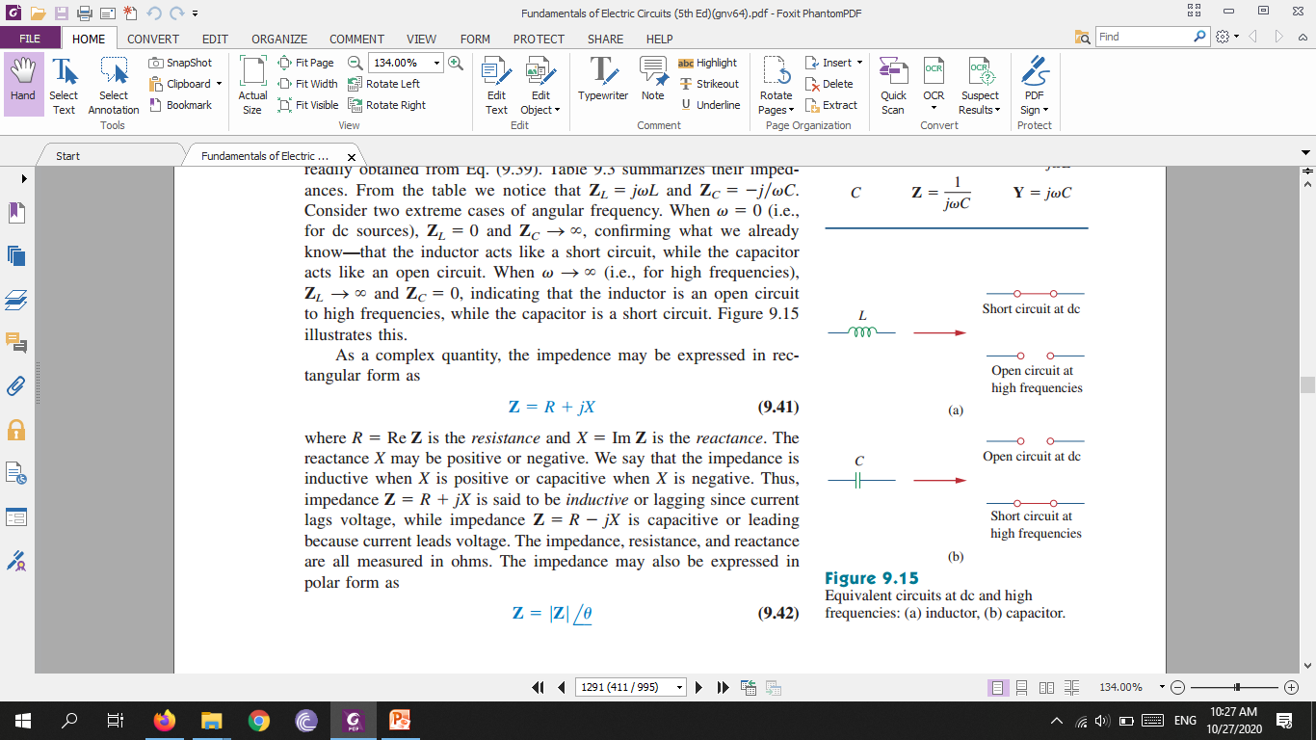

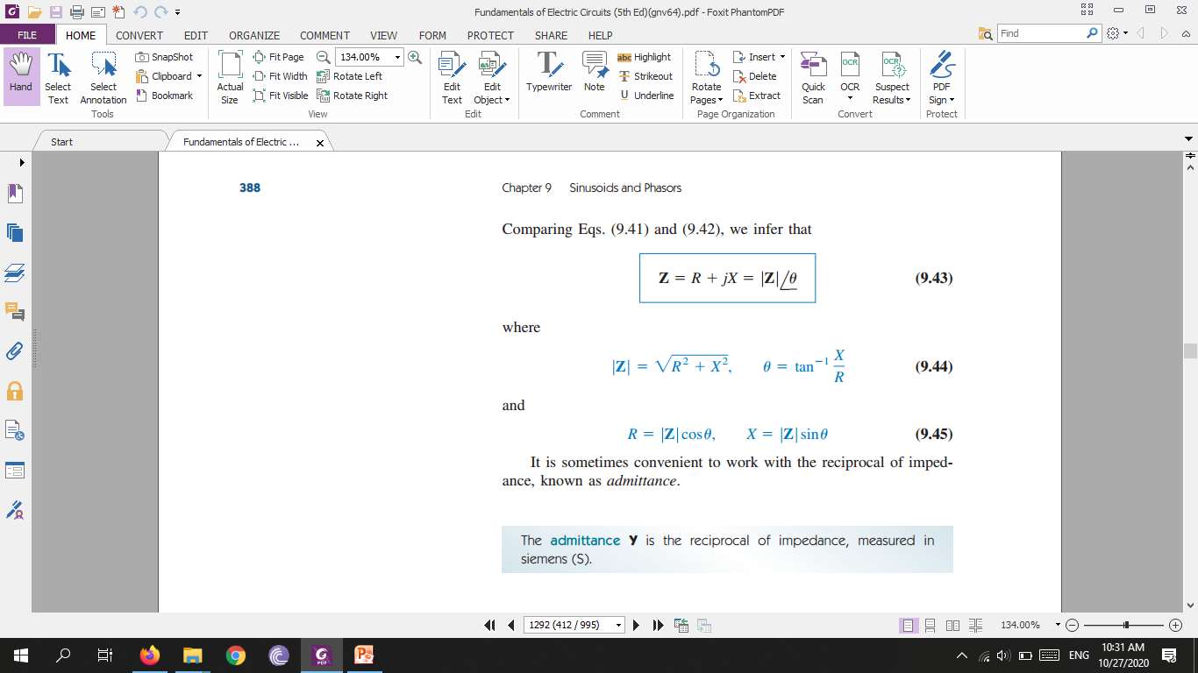
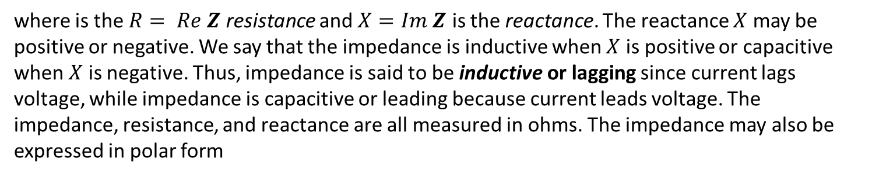
where is the $R= Re Z$ resistance and $X=Im Z$ is the reactance. The reactance $X$ may be positive or negative. We say that the impedance is inductive when $X$ is positive or capacitive when $X$ is negative. Thus, impedance is said to be inductive or lagging since current lags voltage, while impedance is capacitive or leading because current leads voltage. The impedance, resistance, and reactance are all measured in ohms. The impedance may also be expressed in polar form
Admittance is measured in siemens (S)

Slide 7
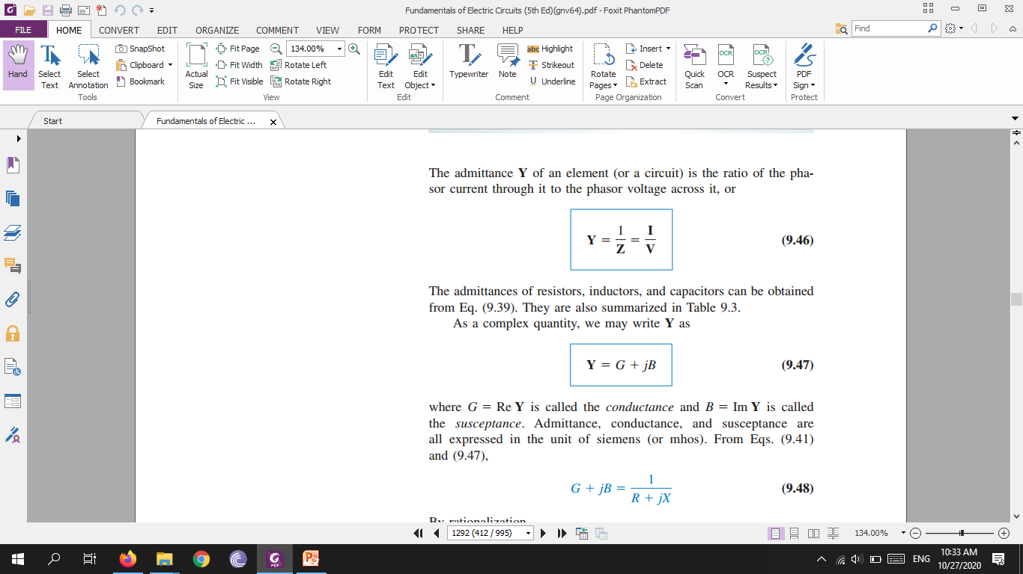
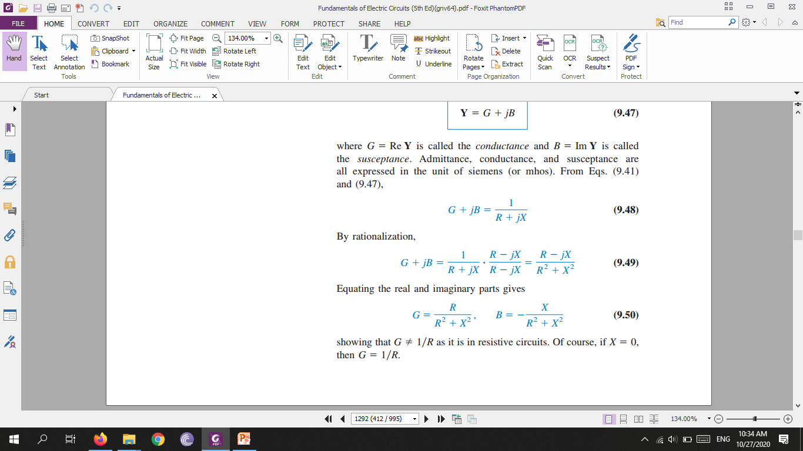

Slide 8
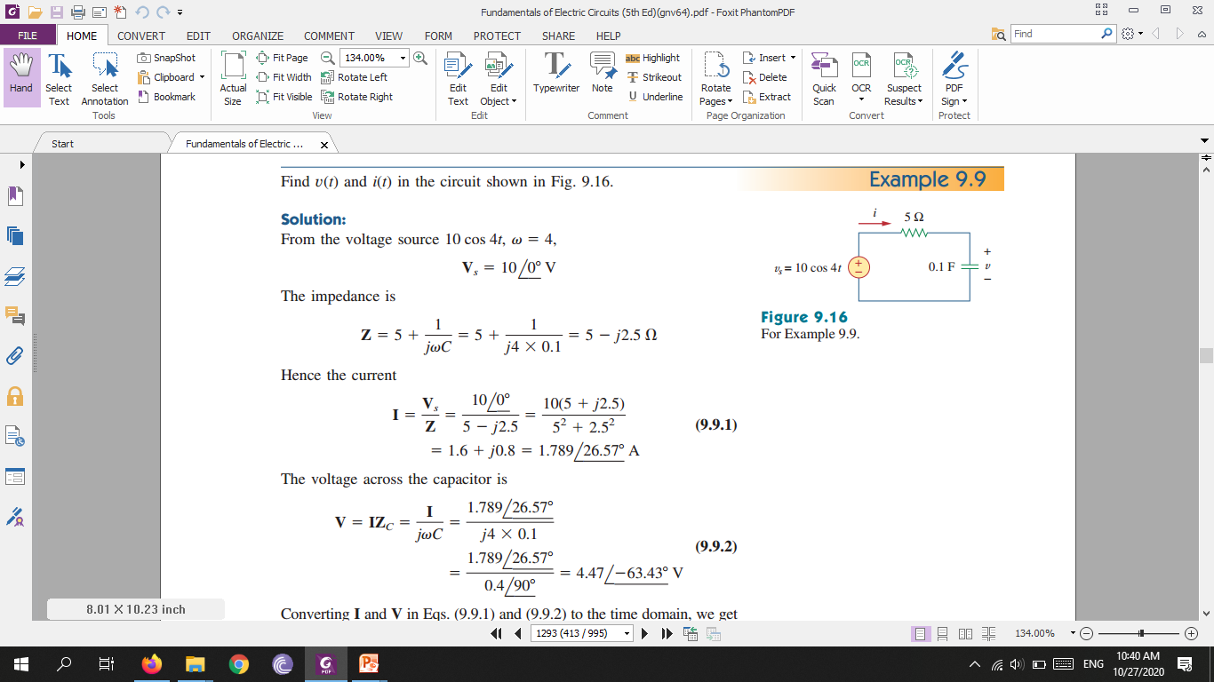
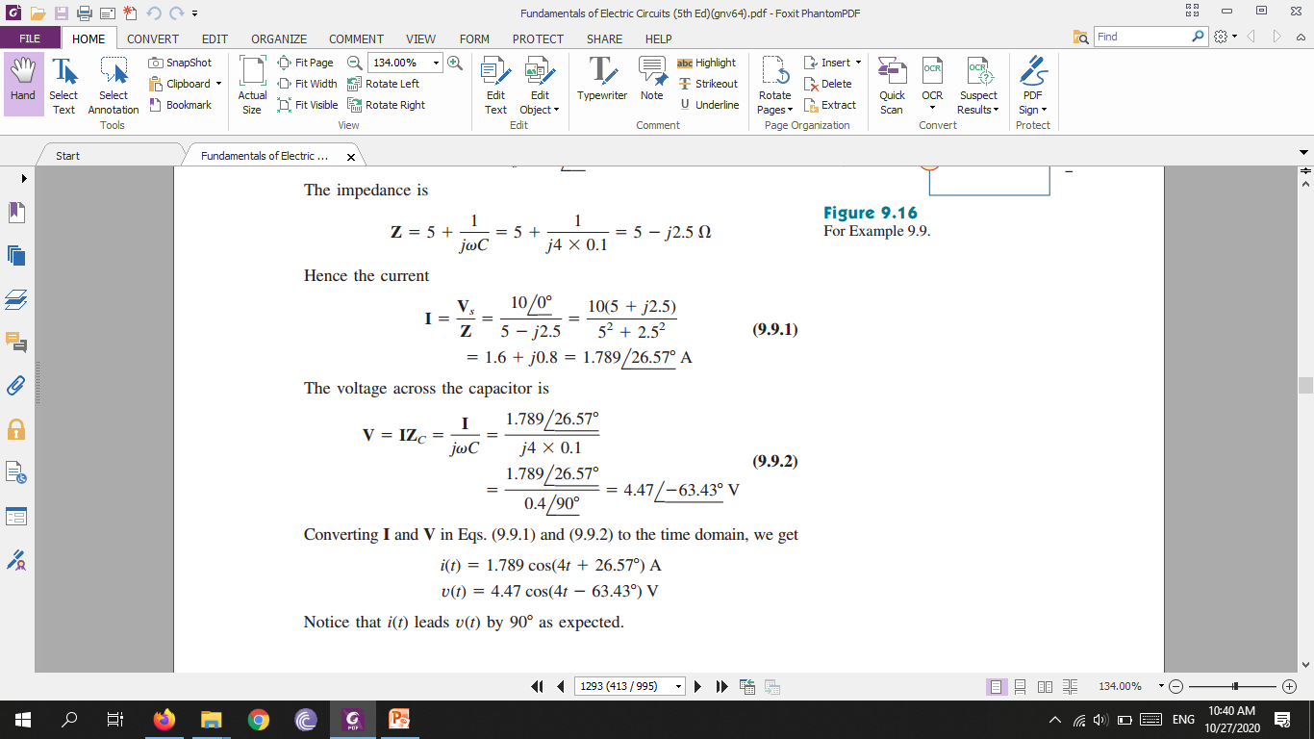

Slide 9
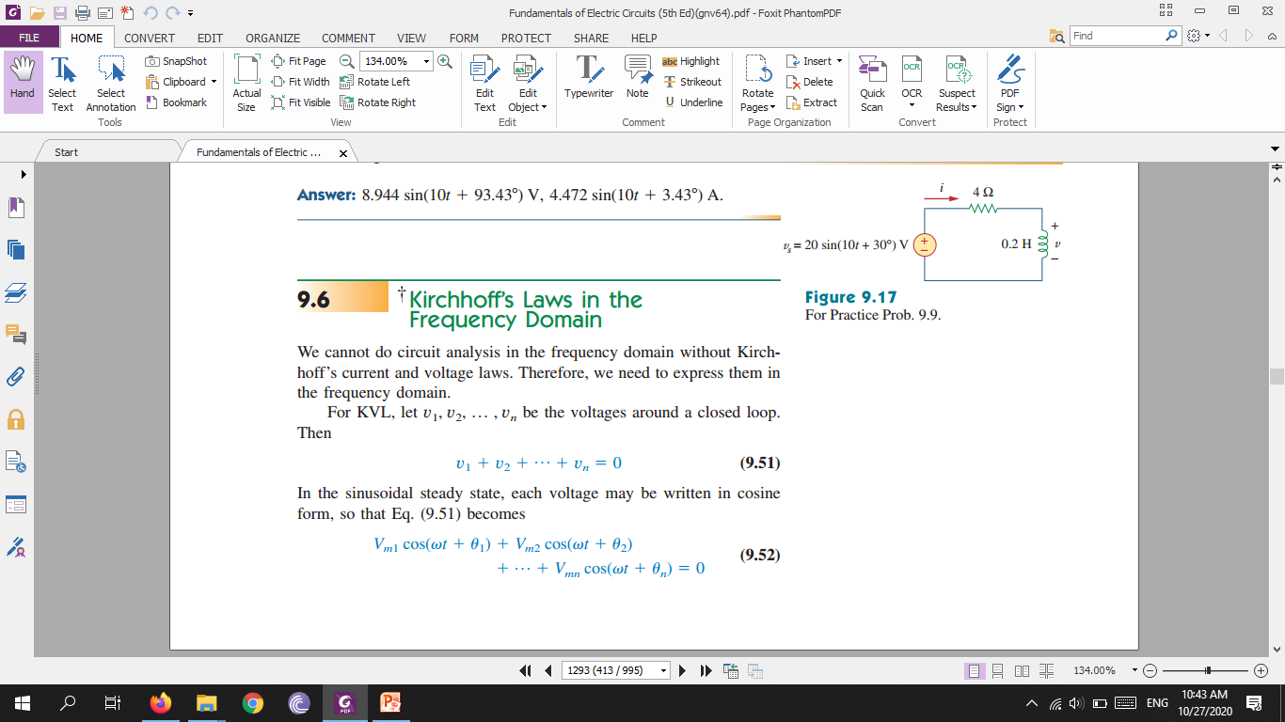
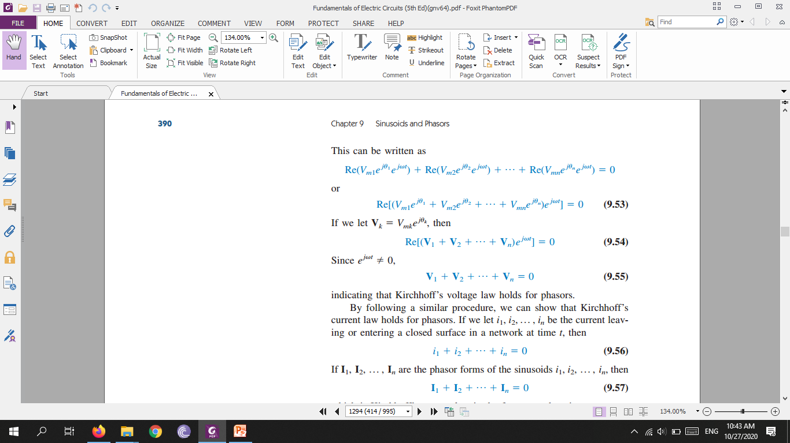
Kirchhoff’s Laws in the Frequency Domain

Slide 10
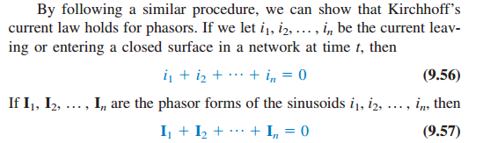

Slide 11
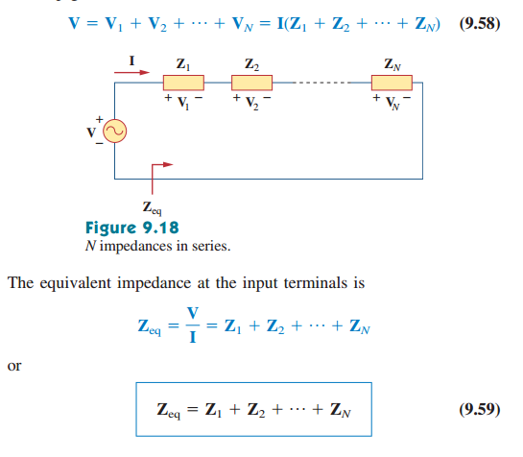
Impedance Combinations

Slide 12
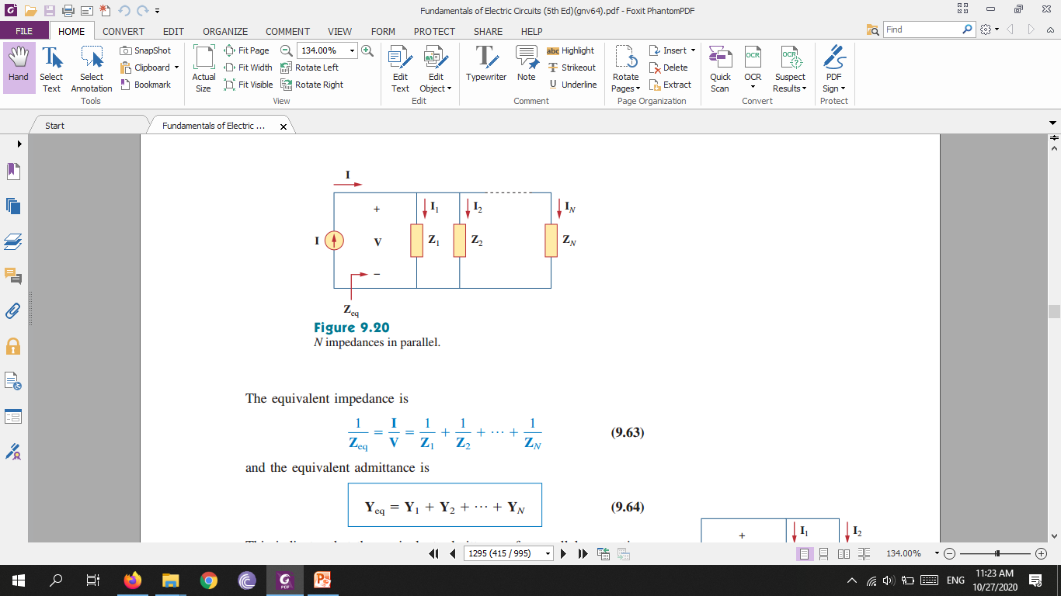
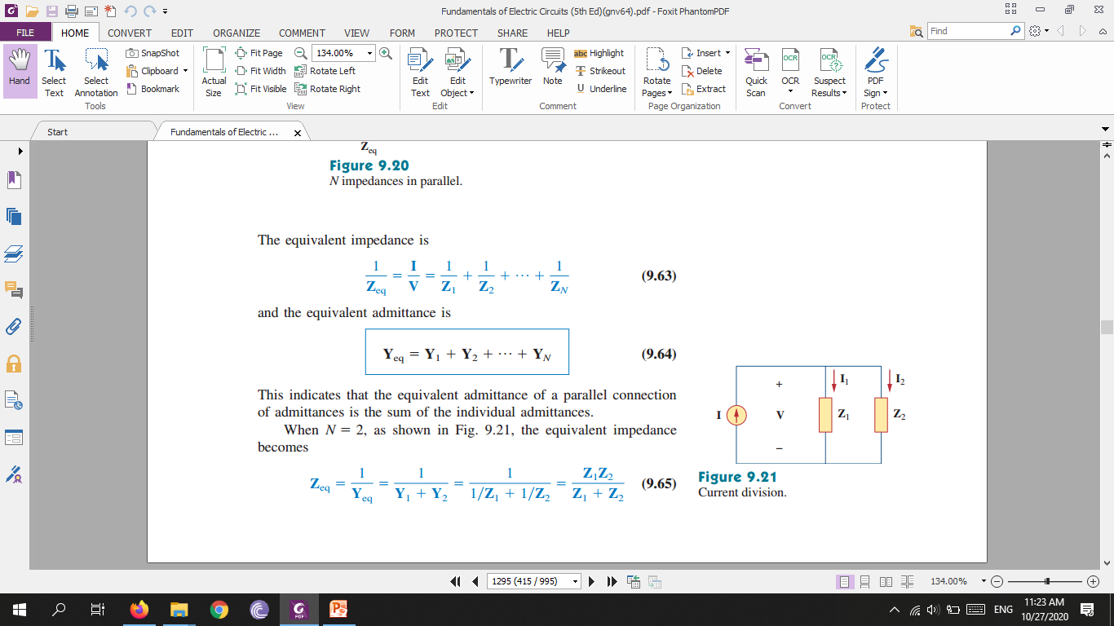

Slide 13
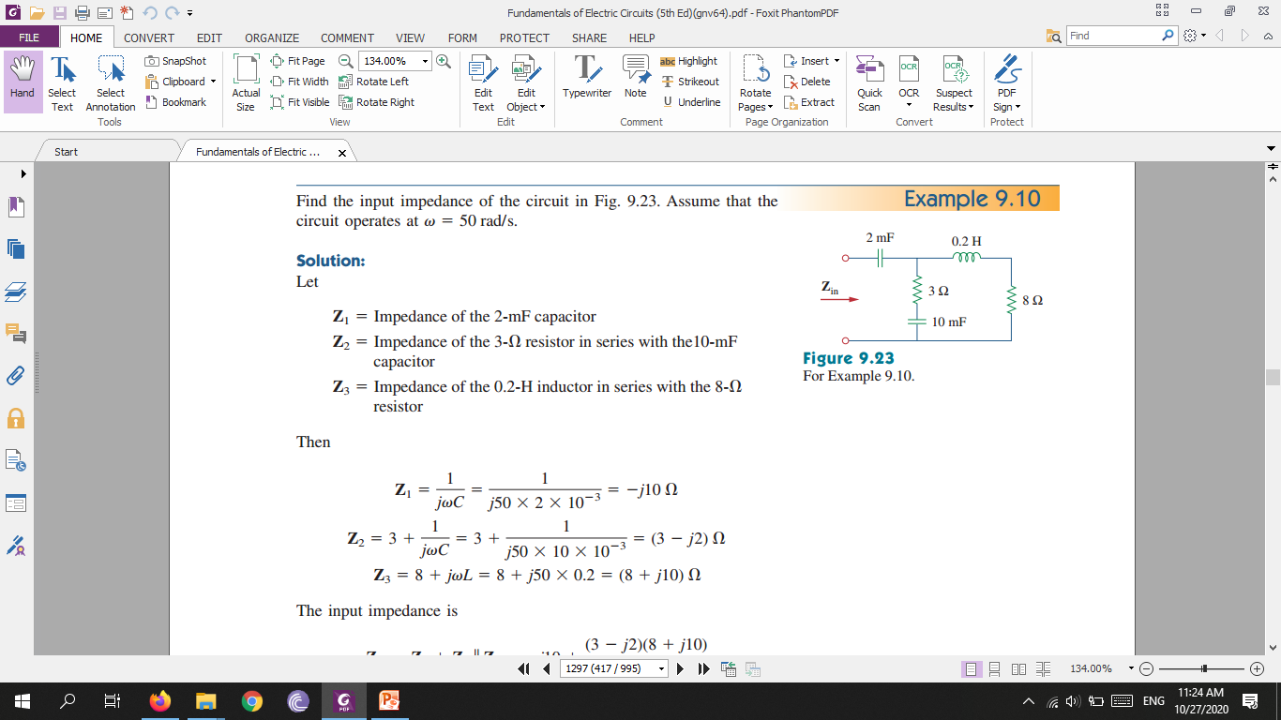
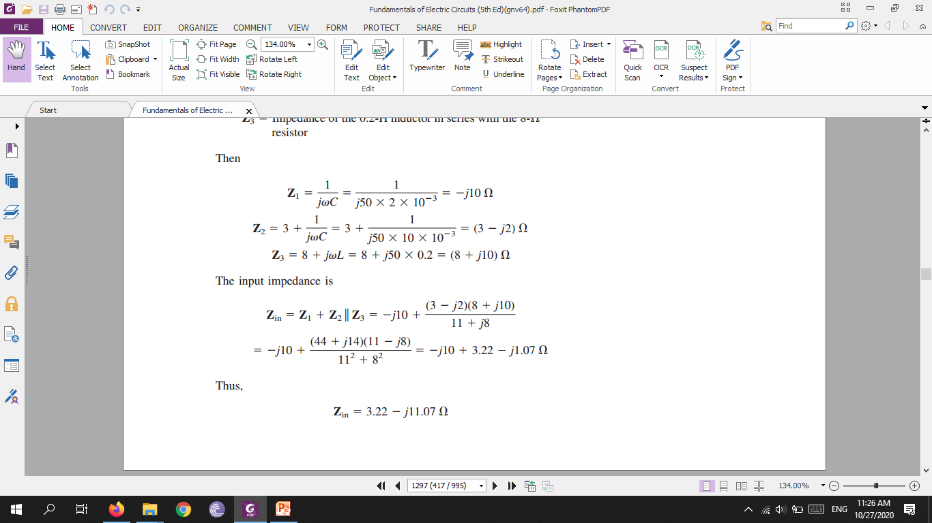

Slide 14
